Slide 1
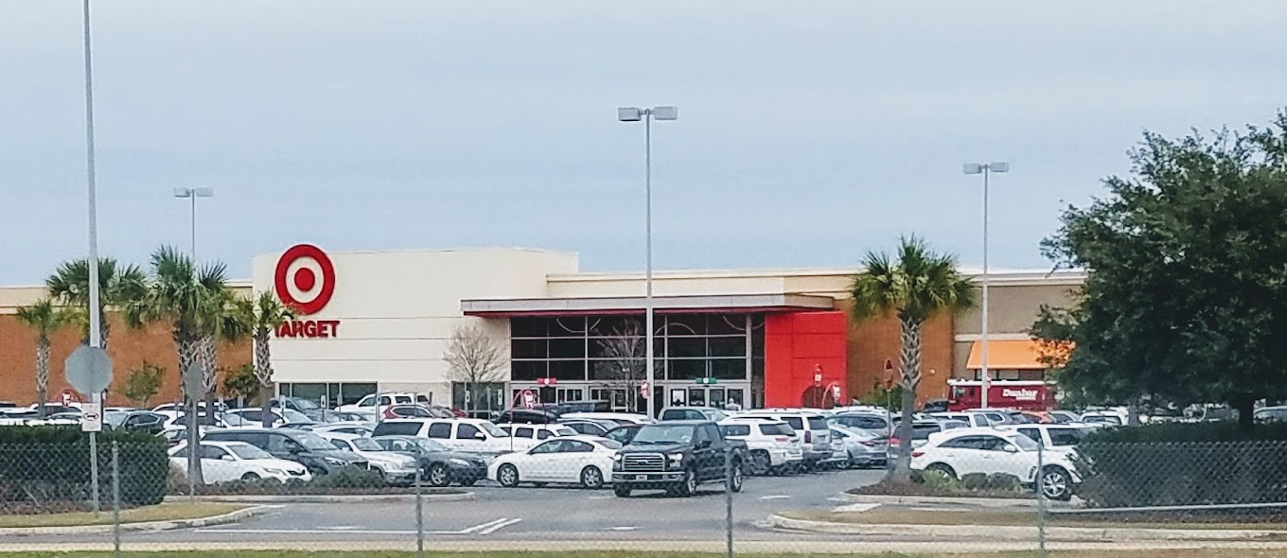
Critical Incident Management
Hammond, Louisiana
June 6, 2020
Chief Edwin Bergeron Jr Hammond Police Department

Slide 2
WHAT IS
Critical Incident Management?
What does this guy know about
Major Incidents?
Notes:
Aligning of operations, services, and functions to manage high-priority assets and situations.

Slide 3
Protests
Target Incident
Jail Suicide
Officer Involved Shooting
COVID
IDA
Hammond High Graduation Shooting
Computer Hacking
Pursuit Fatality

Slide 4
“Not in my city”
"Why Not”

Slide 5
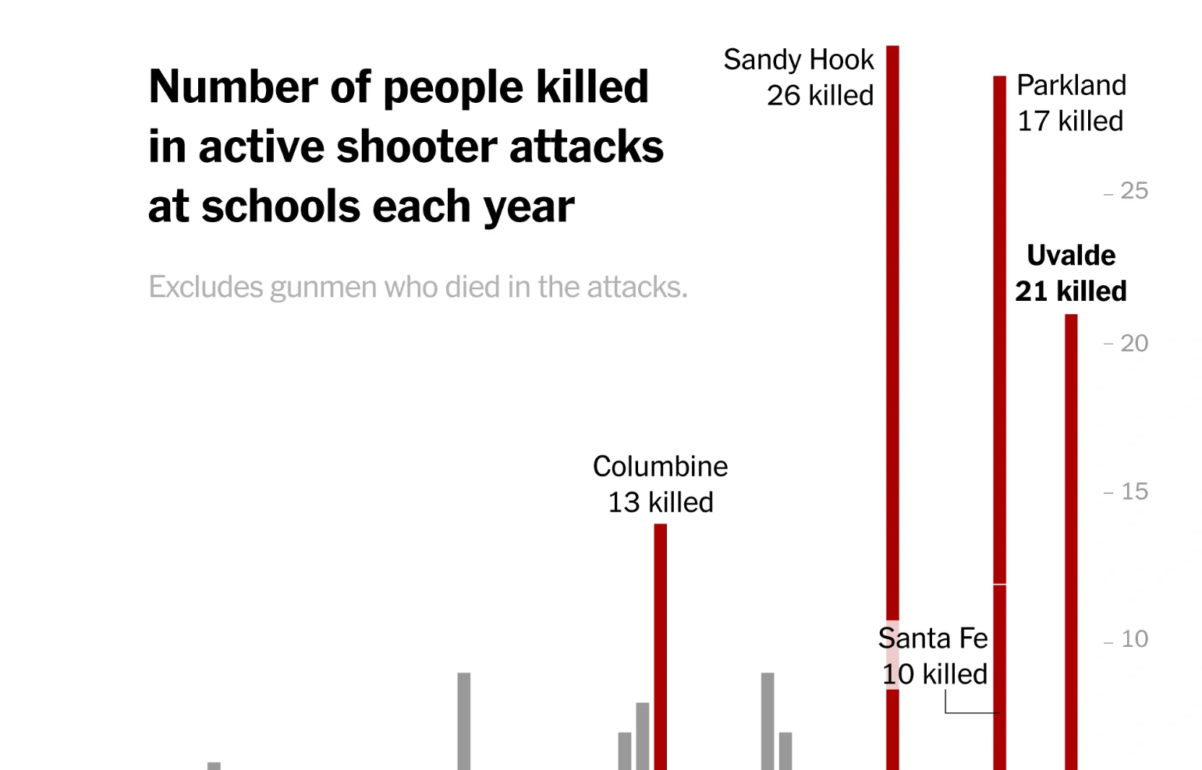

Slide 6
Incident Management
is as easy as riding a bike.

Slide 7
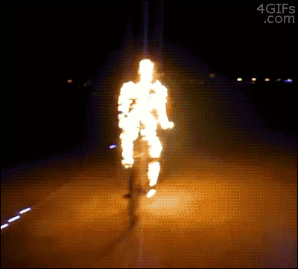
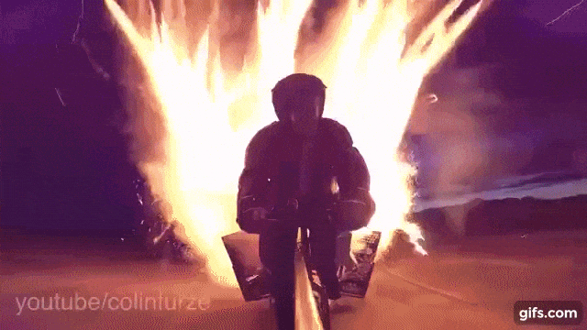
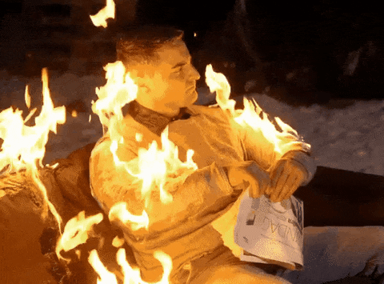
EXCEPT

Slide 8
Active Attack
Begins 1202 hours
In Custody 1208 hours

Slide 9
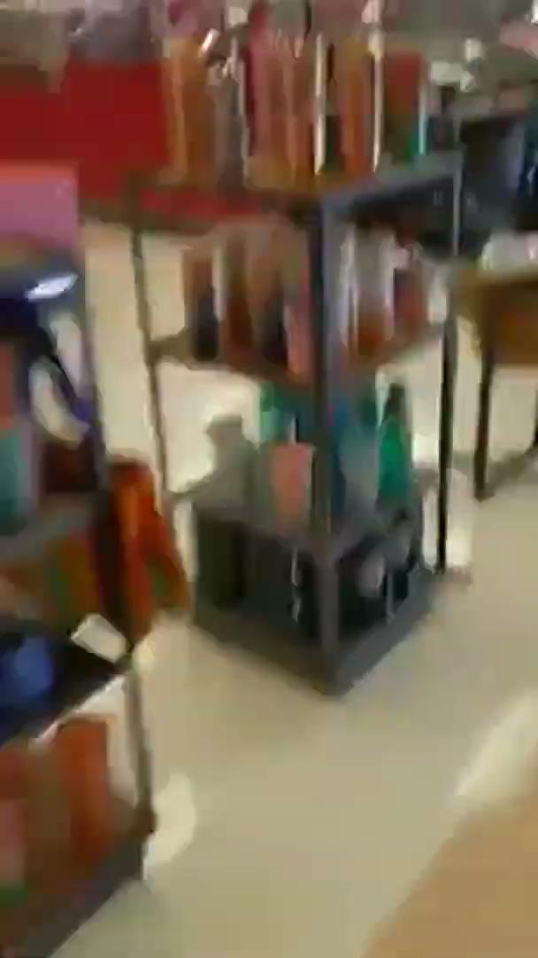

Slide 10

First 911 Call
911 CALLS
CONTINUOUS 911 CALLS
OFFICERS ONSCENE
SECONDARY ENTRY
PRESSING THE SUSPECT
SUSPECT APPREHENSION
CLEARING AND SECURING THE SCENE
DISPATCHING UNITS
ASSISTANCE FROM ADDITIONAL AGENCIES

Slide 11
First Dispatch of Officers
911 CALLS
CONTINUOUS 911 CALLS
OFFICERS ONSCENE
SECONDARY ENTRY
PRESSING THE SUSPECT
SUSPECT APPREHENSION
CLEARING AND SECURING THE SCENE
DISPATCHING UNITS
ASSISTANCE FROM ADDITIONAL AGENCIES

Slide 12
911 Call’s
Time: 1202 hrs
31 sec
911 CALLS
CONTINUOUS 911 CALLS
OFFICERS ONSCENE
SECONDARY ENTRY
PRESSING THE SUSPECT
SUSPECT APPREHENSION
CLEARING AND SECURING THE SCENE
DISPATCHING UNITS
ASSISTANCE FROM ADDITIONAL AGENCIES

Slide 13
Officers Looking for Suspect
911 CALLS
CONTINUOUS 911 CALLS
OFFICERS ONSCENE
SECONDARY ENTRY
PRESSING THE SUSPECT
SUSPECT APPREHENSION
CLEARING AND SECURING THE SCENE
DISPATCHING UNITS
ASSISTANCE FROM ADDITIONAL AGENCIES

Slide 14
First Officer on Scene
911 CALLS
CONTINUOUS 911 CALLS
OFFICERS ONSCENE
SECONDARY ENTRY
PRESSING THE SUSPECT
SUSPECT APPREHENSION
CLEARING AND SECURING THE SCENE
DISPATCHING UNITS
ASSISTANCE FROM ADDITIONAL AGENCIES

Slide 15


Slide 16
LA State Police
911 CALLS
CONTINUOUS 911 CALLS
OFFICERS ONSCENE
SECONDARY ENTRY
PRESSING THE SUSPECT
SUSPECT APPREHENSION
CLEARING AND SECURING THE SCENE
DISPATCHING UNITS
ASSISTANCE FROM ADDITIONAL AGENCIES

Slide 17
Second Entry of Officers
911 CALLS
CONTINUOUS 911 CALLS
OFFICERS ONSCENE
SECONDARY ENTRY
PRESSING THE SUSPECT
SUSPECT APPREHENSION
CLEARING AND SECURING THE SCENE
DISPATCHING UNITS
ASSISTANCE FROM ADDITIONAL AGENCIES

Slide 18
Press the Suspect
911 CALLS
CONTINUOUS 911 CALLS
OFFICERS ONSCENE
SECONDARY ENTRY
PRESSING THE SUSPECT
SUSPECT APPREHENSION
CLEARING AND SECURING THE SCENE
DISPATCHING UNITS
ASSISTANCE FROM ADDITIONAL AGENCIES

Slide 19
Suspect Exits / Att Car Jack / Tased
911 CALLS
CONTINUOUS 911 CALLS
OFFICERS ONSCENE
SECONDARY ENTRY
PRESSING THE SUSPECT
SUSPECT APPREHENSION
CLEARING AND SECURING THE SCENE
DISPATCHING UNITS
ASSISTANCE FROM ADDITIONAL AGENCIES

Slide 20
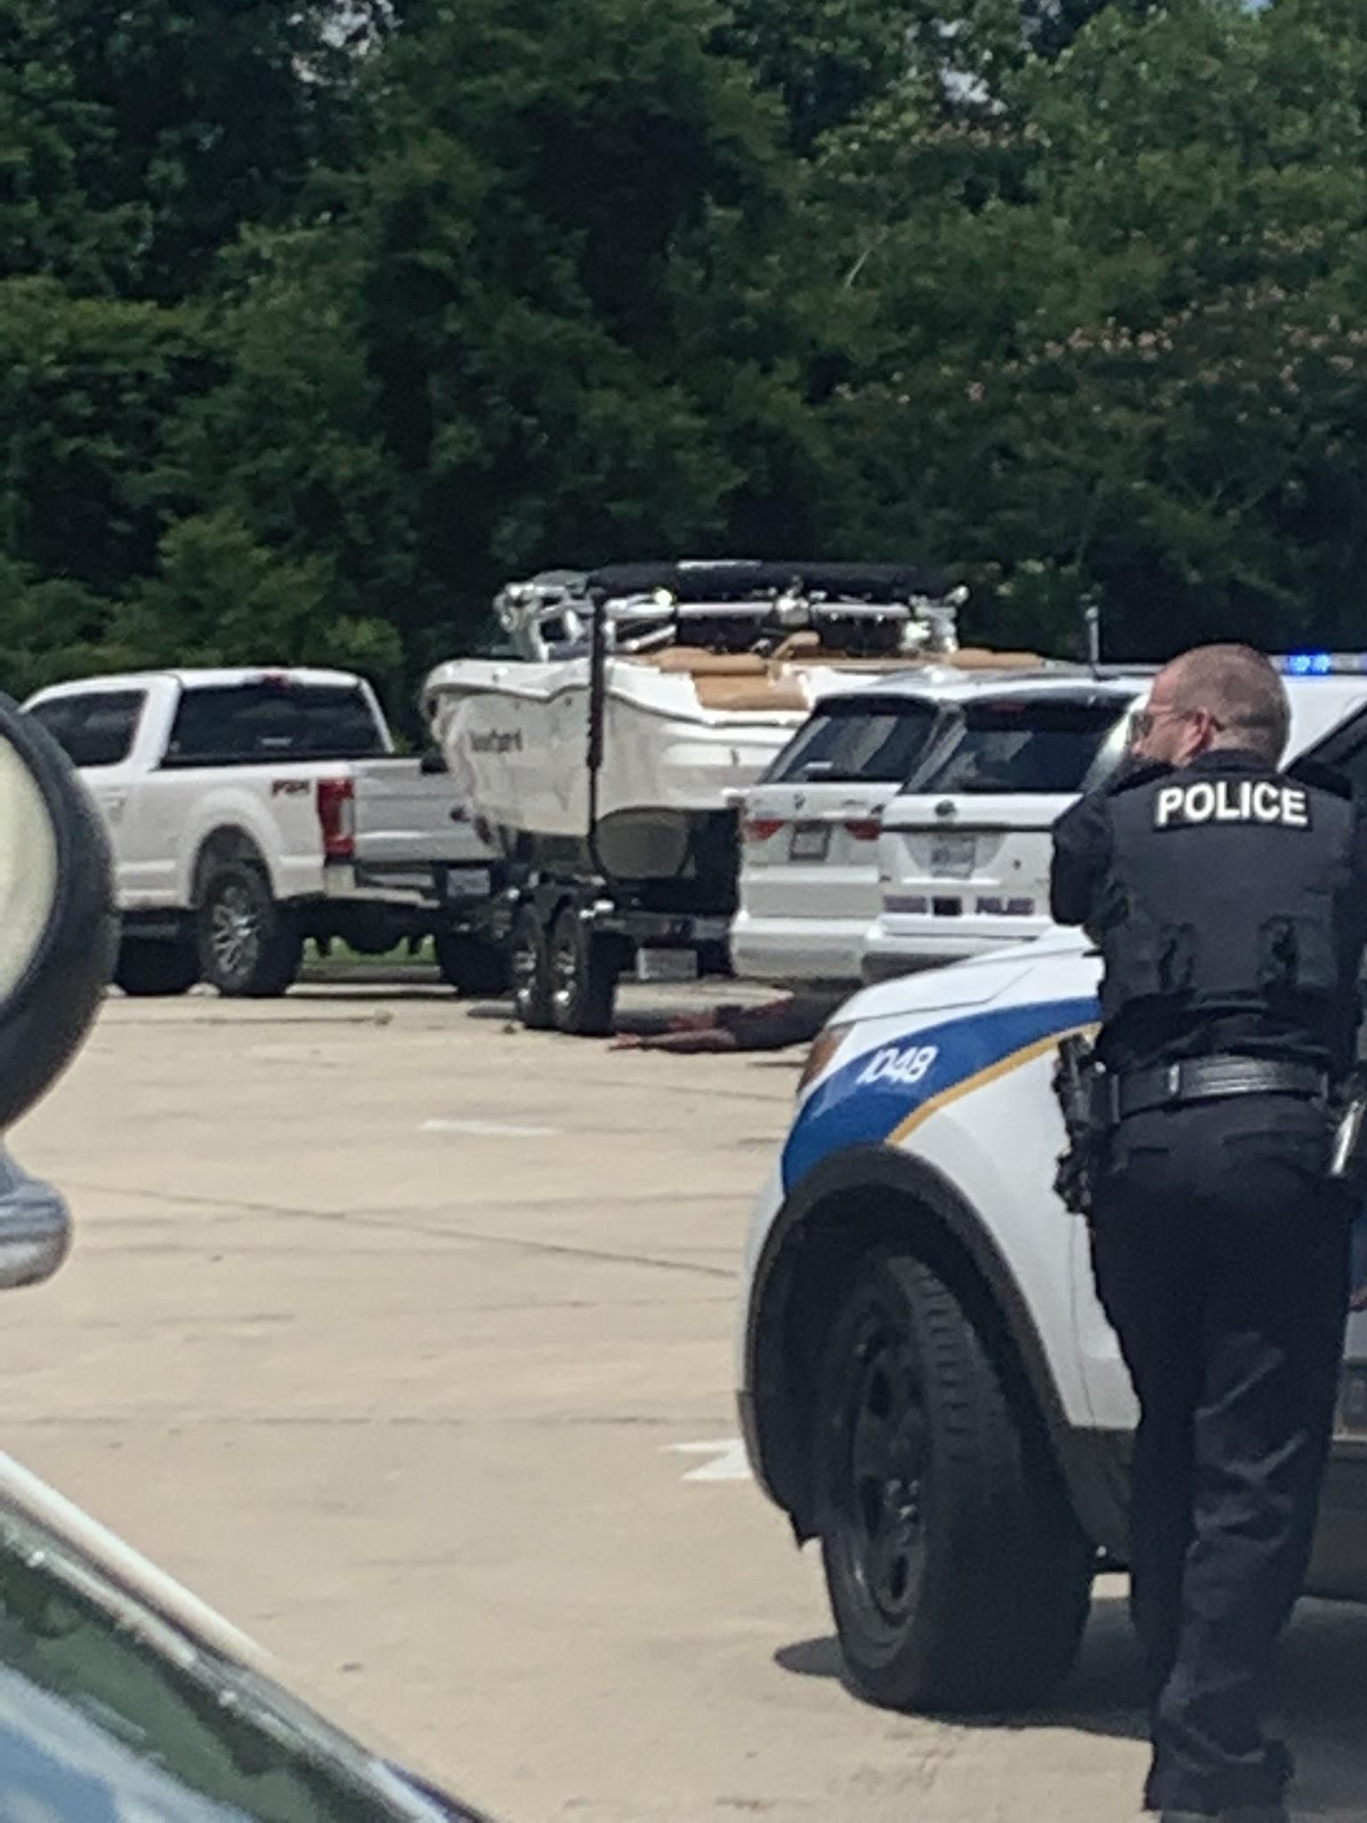

Slide 21
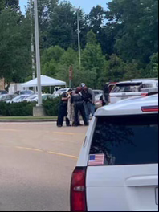

Slide 22
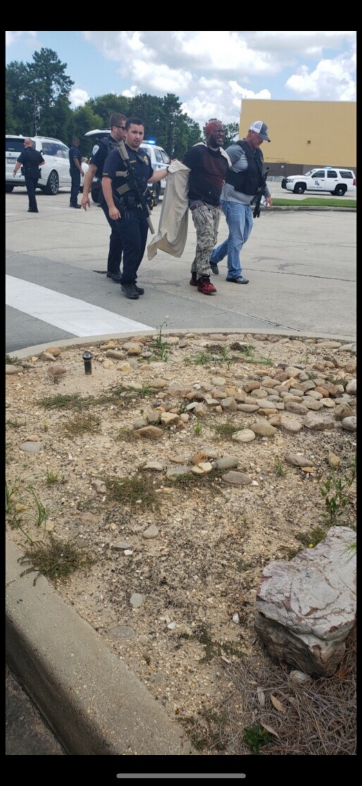

Slide 23
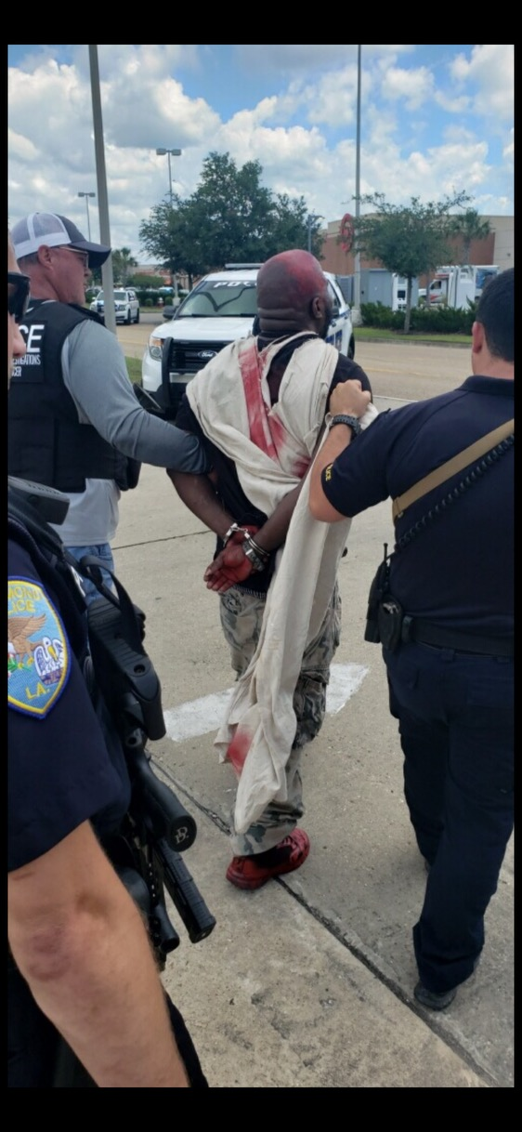

Slide 24
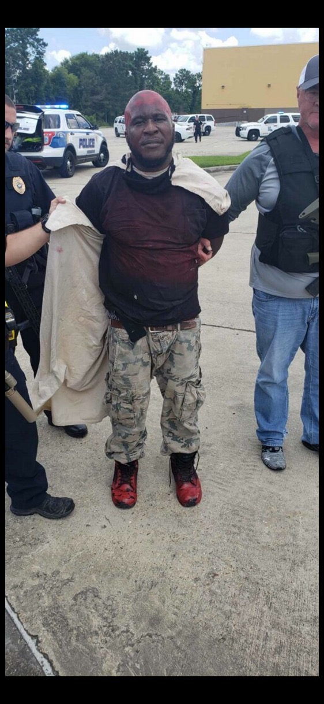

Slide 25
K9 Clearing Target
911 CALLS
CONTINUOUS 911 CALLS
OFFICERS ONSCENE
SECONDARY ENTRY
PRESSING THE SUSPECT
SUSPECT APPREHENSION
CLEARING AND SECURING THE SCENE
DISPATCHING UNITS
ASSISTANCE FROM ADDITIONAL AGENCIES

Slide 26
Bomb Squad Call
911 CALLS
CONTINUOUS 911 CALLS
OFFICERS ONSCENE
SECONDARY ENTRY
PRESSING THE SUSPECT
SUSPECT APPREHENSION
CLEARING AND SECURING THE SCENE
DISPATCHING UNITS
ASSISTANCE FROM ADDITIONAL AGENCIES

Slide 27
Identifying Multiple Bombs
Officers identified possible Bombs on the suspect’s person and scattered amongst Target.
4-5 possible bombs at Hammond Square

Slide 28
Clear the Circle
1st Attempt to begin securing the area.

Slide 29
TPSO Location of bombs in other Locations

Slide 30
Subject with a Gun At TJ Maxx

Slide 31
TJ Maxx - Code 4

Slide 32
Gun Call at Academy

Slide 33
ID Citizen

Slide 34
All 3 Locations Linked to Suspect

Slide 35
Possible Gunman at JC Penney

Slide 36
JC Penney – Plain Clothes LSP

Slide 37
Command Post Established

Slide 38
The Next 100 Calls

Slide 39
Recap:
1201 hours - Received first call
1202 hours - Officers responding from Albasha
1203 hours - 2 Officers arrive on scene from Albasha
1204 hours - 3rd officer arrives at Target front door.
1205 hours - All 3 make entry
1206 hours - Press suspect to side of store
1207 hours - Suspect Exits store
1207 hours - Suspect attempts to carjack person in parking lot
1207 hours - Suspect runs to AMC Lot
1208 hours - Suspect is Tased
1208 hours - Suspect has packaged strapped on his person.
1208 hours - Package falls to ground when tased.
1208 hours Suspect taken into Custody
1208 hours - K9 clearing the business
1209 hours - Officers on scene requesting a bomb squad
1212 hours - Officers identifying multiple “possible” bombs
1220 hours - Clearing the circle
1221 hours - Other bomb locations
1225 hours - Subject with a gun at TJ MAXX
1225 hours - Code 4
1226 hours - Gun call at Academy
1230 hours - ID Citizen
1230 hours - 3 Locations linked to suspect
1232 hours - possible gunman at JCPenney
1232 hours - LSP on scene to assist at JCPenney
1233 hours - Command Post established

Slide 40
After Custody
Establish a Command Post and Command Staff Meeting
Secure the Area
Media
Bomb Investigation
Manpower
Evidence Collection
Investigation
All Clear Status
Prosecution

Slide 41
Establish a Command Post

Slide 42
Secure the Area
How Do you Secure an area where a Major Incident occurred?
Barricades
Entrances / Exits
Clear all surrounding businesses / homes
Mark the locations safe after clearing them.
Evacuation plans

Slide 43
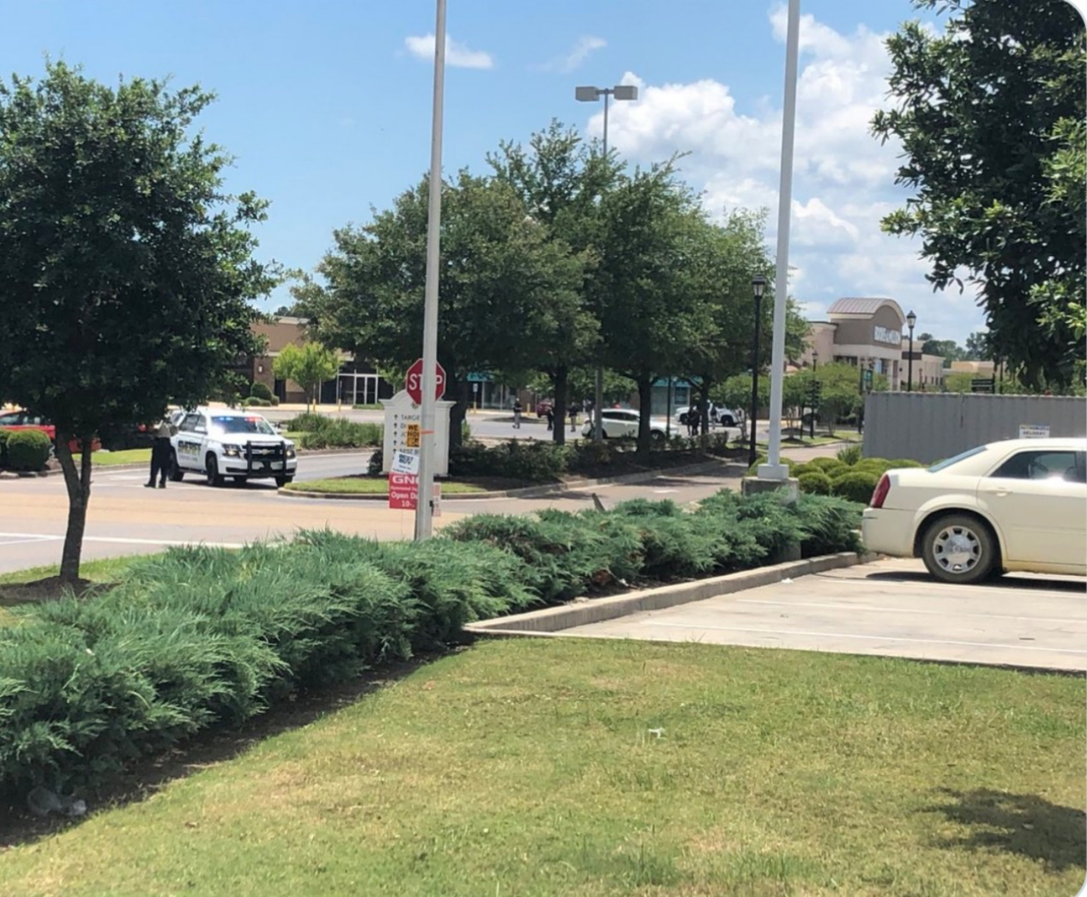

Slide 44
Manpower
Do you have enough?
Do you need more?
What do you do with everyone?

Slide 45
Media Crap Show
Local Media Report: Hammond PD Shoots Suspect
Social Media Blow Up
False Narratives
People Shot
Other News Outlets Reporting
LA State Police PIO arrives on scene

Slide 46
1210 hours
Local media, Hammond Daily Star, reports that
HPD Shot the suspect on Facebook.

Slide 47


Slide 48
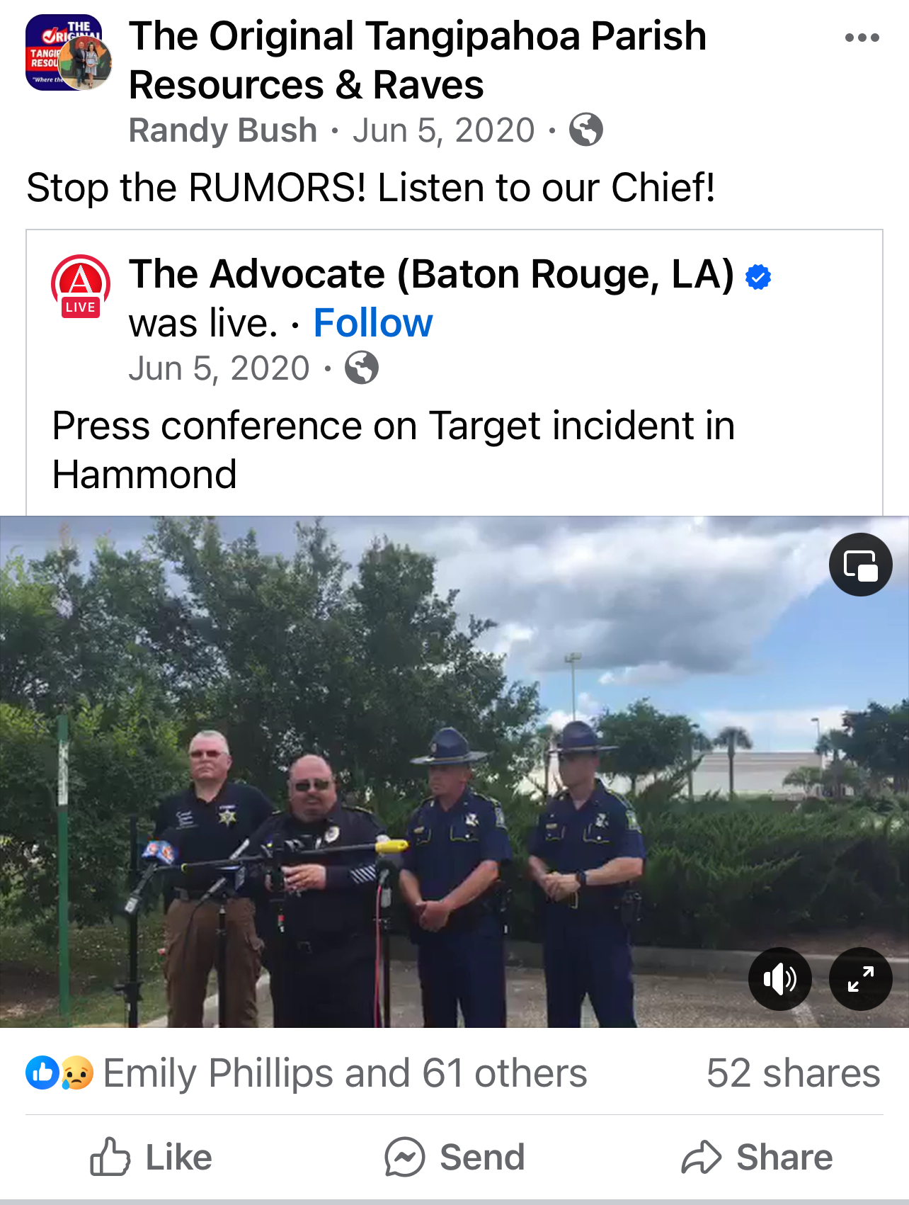

Slide 49
Explosive Device Disposal

Slide 50

Evidence Collection

Slide 51
Investigation

Slide 52
Prosecution

Slide 53
This Major Incident consisted of:
16 Different Agencies
&
24 Different Divisions

Slide 54
Hammond Police Department
Hammond Fire Department Hammond Streets Department
Hammond Maintenance Dept Hammond Mayor's Office
LA State Police Detectives LA State Police Patrol
LA State Police Bomb Squad LA State Police SWAT Team
LA State Police PIO FBI Counter Terrorism Agents
FBI Evidence Recovery Team US Dept of Homeland Security
ATF Southeastern PD
TPSO Patrol St. John S.O.
Livingston Parish S.O. Tangipahoa Parish EOC
Acadian Ambulance St. Tammany Parish Bomb Squad
US Air And Marine Tangipahoa Parish Pres Office
US Secret Service

Slide 55
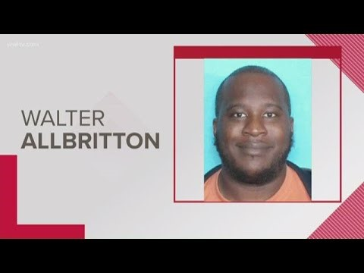

Slide 56
Sentencing - 25 years
“Walter Allbritton III, 44, of Ponchatoula, was sentenced to 25 years in prison by Judge Jeffrey S. Johnson after pleading no contest to first degree robbery, two counts of attempted first degree robbery, terrorism, terrorizing, fake explosive device and aggravated criminal damage to property, according to the 21st Judicial District Court.”

Slide 57
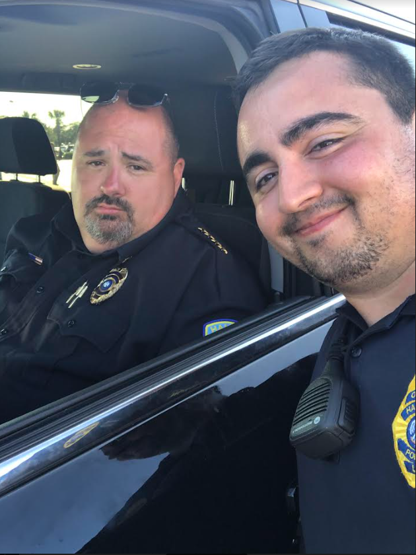

Slide 58
The biggest question is how do we respond to future Major Incidents?
Have a PLAN:
Prepare
Learn
Act
Notify
Notes:
Dispatch and Police communication
Everyone has preplanned individual tasks and duties.
Surrounding agency task planning
What can be taken away from previous incidents?
Know your responsibility to act

Slide 59
Prepare
Set your team up for success
Have an active plan put in place for a Major Incident response
Have an active plan with surrounding agencies
Have proper training put in place
(It is better to have it and not need it, than need it and not have it)

Slide 60
Major Incident Checklist
HPD Dispatch Radio Channel:________________ Net Contact:_______________
Command Center Needed: Yes No Location:______________________
SWAT needed: Yes No
Notified via Kologik: Yes No Staging Area:_________________
Acadian needed: Yes No Staging Area:_________________
HFD Needed: Yes No Staging Area:_________________
Media Staging Area needed: Yes No Staging Area:_________________
Barricades Needed: Yes No Staging Area:_________________
Food / Water needed: (TPEOC) Yes No Staging Area:_________________
NCIC Assisting Agency Request Sent: Yes No
Tangipahoa Parish EOC Needed: Yes No
Hospital Notification Needed Yes No

Slide 61
Learn From Previous Incidents
What did we do right in a previous incident? / What did we do wrong?
Where can we improve?
What will help us next time to be better?

Slide 62
Act With Immediate Response
Move with a purpose
Become a leader
Notes:
Weve all seen the incident where an officer waited for assistance before moving forward into a school where an active shooter was taking lives of children inside of the building.
We know the incident is intimidating, but this is what we signed up for.
This is our duty to act.

Slide 63
Notification of Assisting Agencies / Departments
Identify Support Agencies / Departments
Identify Resources
Understand YOUR role

Slide 64
Hammond Police Department
Agency Incident Card:
Agency Name: Tangipahoa Parish EOC
Contact Info: Dawson Primes
Agency Resources: Command Bus
Food & Water
Transportation Buses
High Water Vehicles

Slide 65
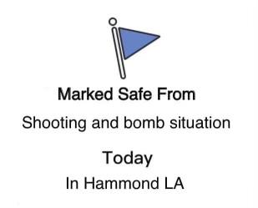

Slide 66
Major Incident Response in Real Time
Chief Edwin Bergeron Jr
Hammond Police Department
Bergeron_ej@Hammond.org
Office (985) 277-5750
Cell (985) 969-4101

